Slide 1

CNSCC.203 Computer Networks Computer Networks and the Internet
Muhammad Azhar Iqbal
azhar.iqbal@lancaster.ac.uk
Credit goes to Dr. Matt Broadbent, Dr. Vasileios Giotsas, and Dr. Wenjuan Yu at SCC for designing module SCC.203.

Slide 2
About Me
Muhammad Azhar Iqbal
Lecturer (Assistant Professor)
School of Computing and Communications (SCC)
Lancaster University
Research interests
Computer Networks
Internet of Things (IoT)
Parallel Computation
Application of machine learning techniques in Parallel Computing and Networks

Slide 3
How this Course is Taught
Lectures:
Week 1 to 10; Tuesday (From 16:20 to 18:10)
Each session: 1 hour and 50 minutes
Hong Guo Xin Yuan Hotel (二层报告厅)
Labs:
Week 1 to 10, West Siyuan Hall SX710
Group 1 (Friday 10:10-12:00), Group 2 (Thursday 10:10-12:00), Group 3 (Friday 16:20-18:10)
Each session: 1 hour and 50 minutes
Office hours (via MS Teams):
Week 1 to 10 (Monday 11:00 AM - 11:50 AM)

Slide 4
How this Course is Assessed
Coursework: 40% overall weighting
Weighting:
(60%) Network Application Development (by Week 9 Friday)
Building network-oriented applications in Python
(20%) Class Test-1 (by Week 6 Friday)
(20%) Class Test-2 (by Week 10 Friday)
Final Exam: 60% overall weighting
Final exam in December or January
Answer 3 out of 4 questions
We will cover examples of exam questions throughout the module

Slide 5
What is Plagiarism?
Passing off someone else’s work as your own, including:
Submitting (e.g.) code that someone else wrote
Paying for someone else to do it for you
Working on a piece of non-group work together as a group, and submitting it as individual work
Sharing of code that you then possibly adapt
If you give someone else your work, you can also be called in for plagiarism
Coursework submitted online is checked for plagiarism automatically

Slide 6
Topics - First Half of Term
Week 1 | What is the Internet?
 | Network Edge & Network Core
Week 2 | Delay, Loss & Throughput
 | Protocol Layers & Encapsulation
Week 3 | Network Applications
 | Web & HTTP
Week 4 | DNS
 | Email
Week 5 | Network Transport & UDP
 | TCP

Slide 7
Topics - Second Half of Term
Week 6 | Congestion Control
 | Forwarding, IPv4 & Addressing
Week 7 | NAT & DHCP
 | Switching & Routing
Week 8 | Error Detection & Correction
Week 9 | Multiple Access & LANs
Week 10 | Revision

Slide 8
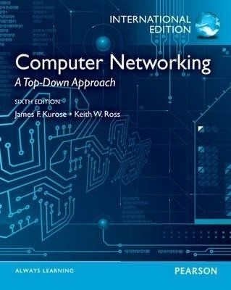


Recommended Reading
Computer Networking: A Top-Down Approach
By James Kurose, Keith Ross
7th Edition or 8th similar enough for the content of this course)
or
or

